Slide 1

Code Modularity

Slide 2

Reference
Chapter 9 (O'Reilly) of Hands-On ML
Youtube
Code

Slide 3
Straight Code

Slide 4
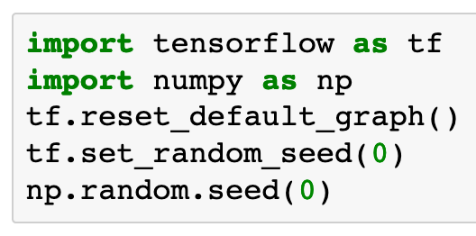

Slide 5
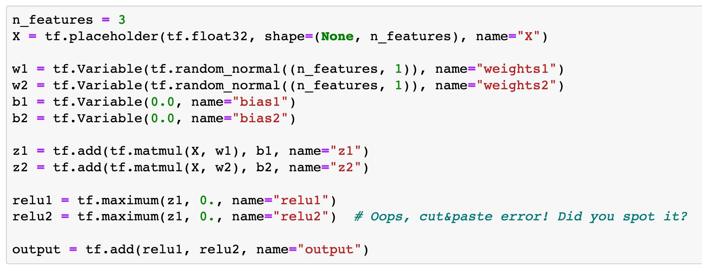

Slide 6
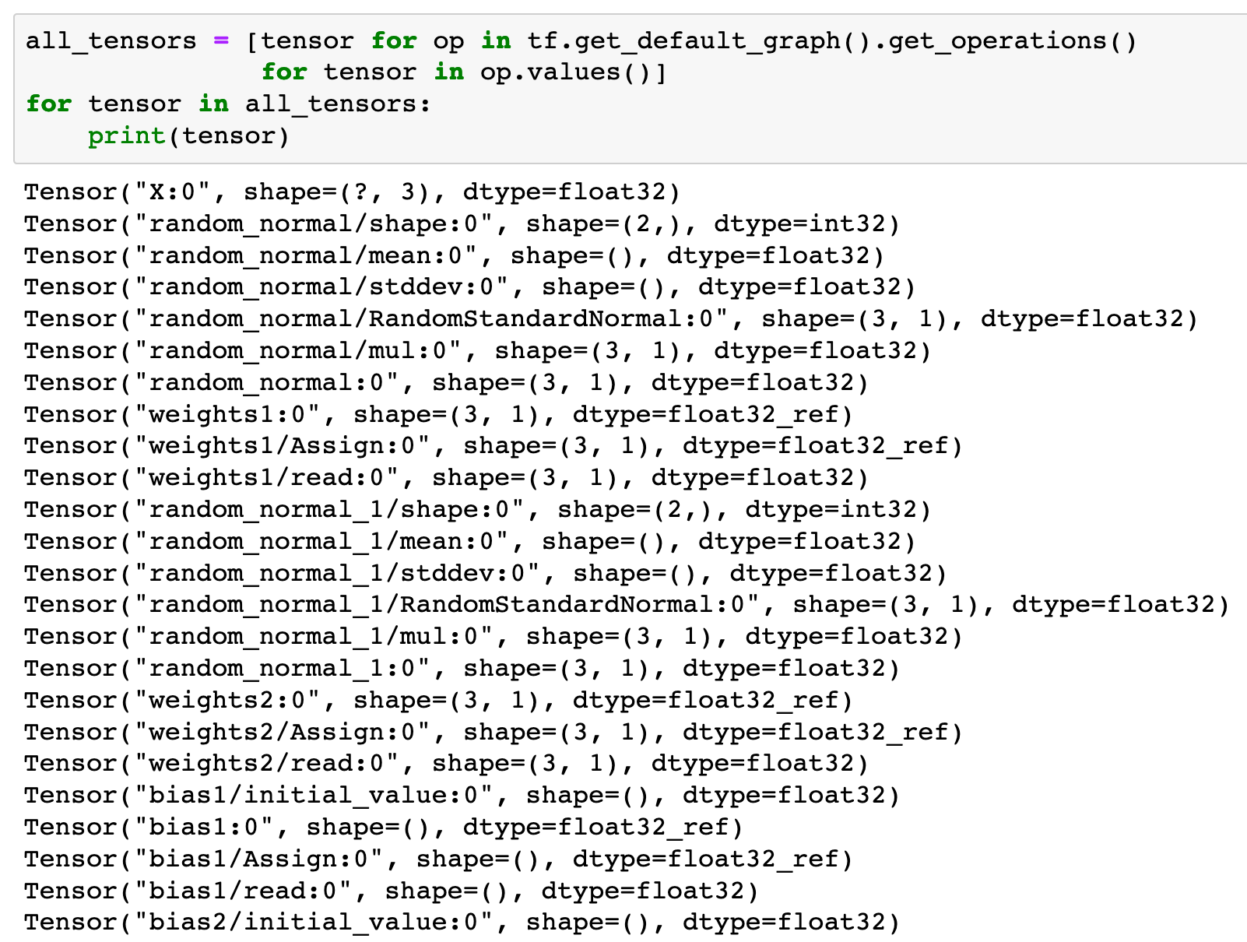

Slide 7
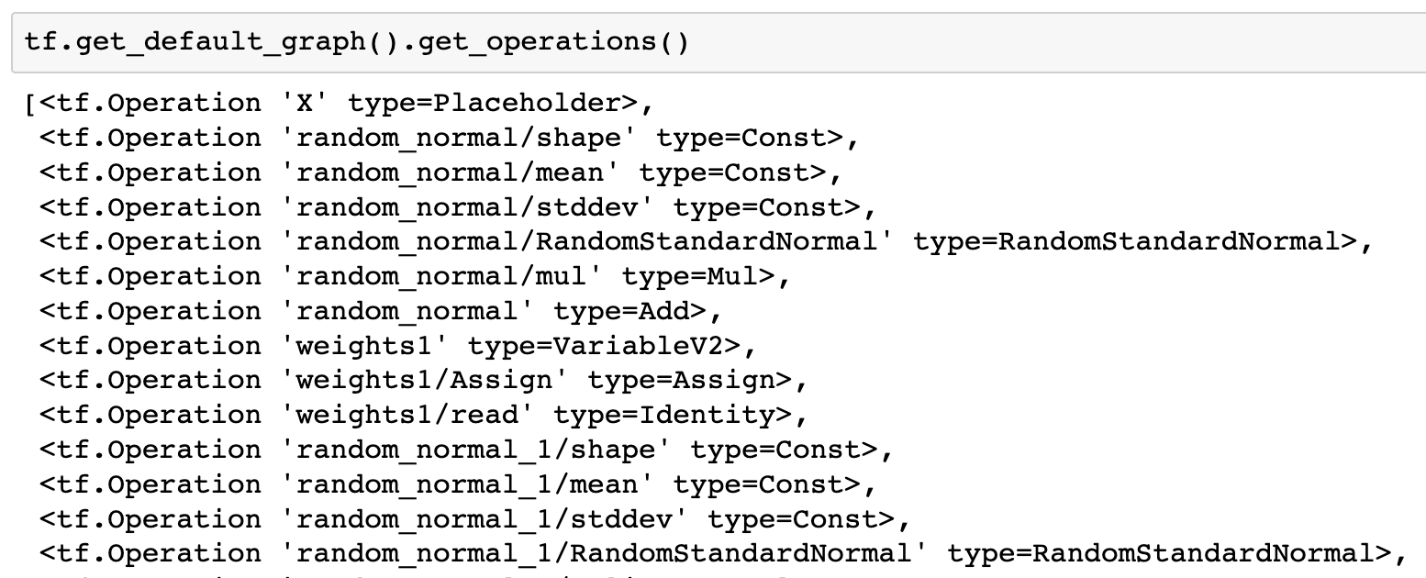

Slide 8
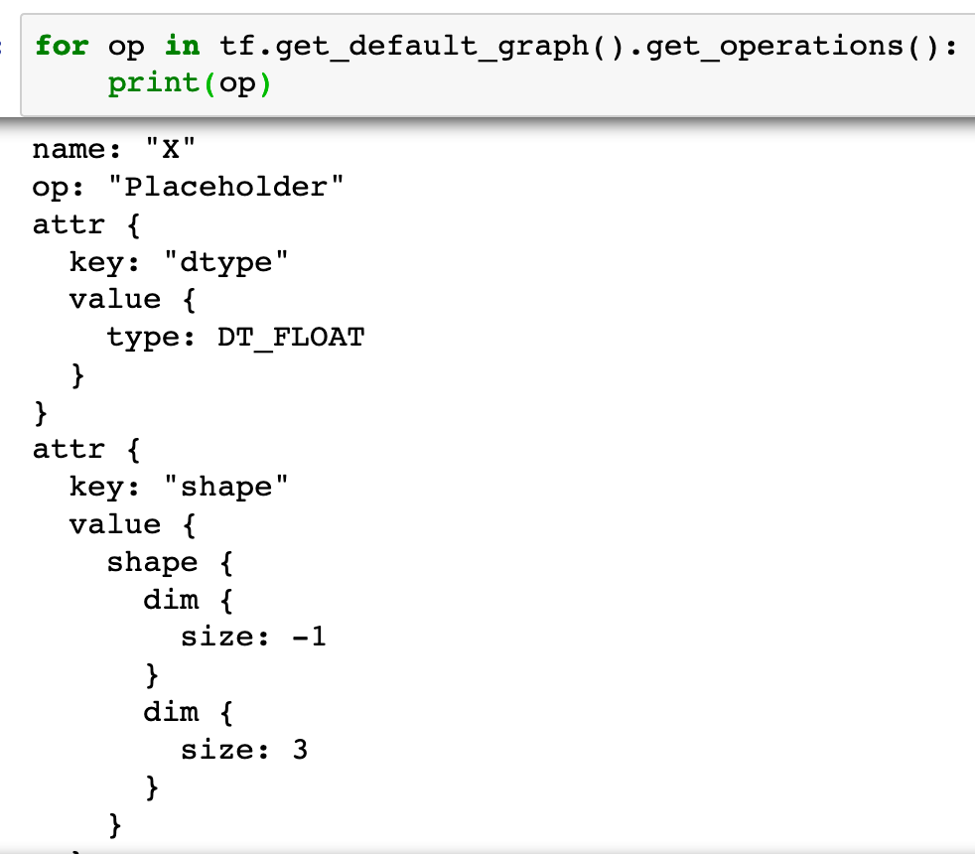

Slide 9
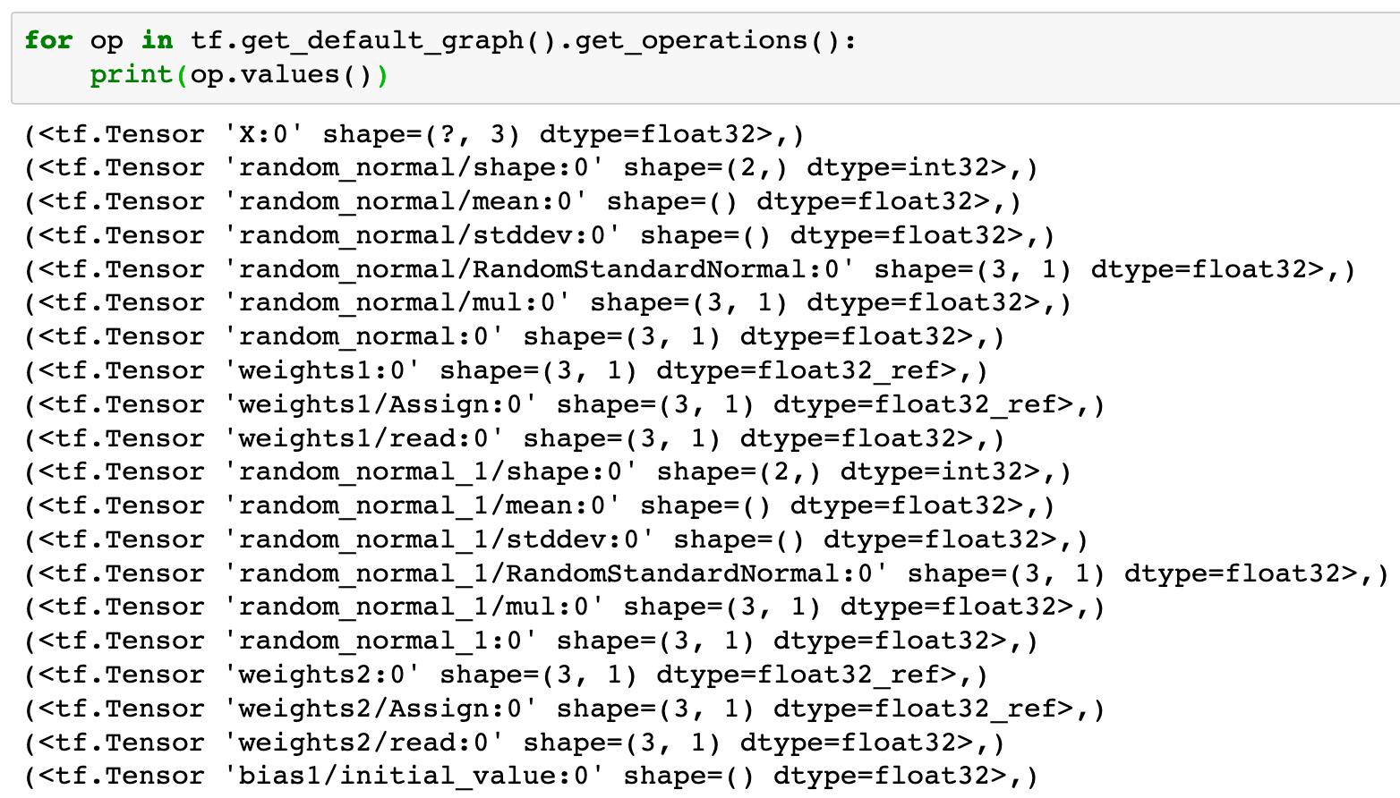

Slide 10
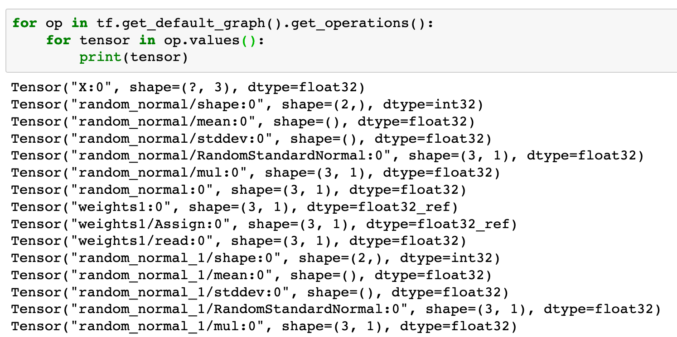

Slide 11
Code Modularity

Slide 13
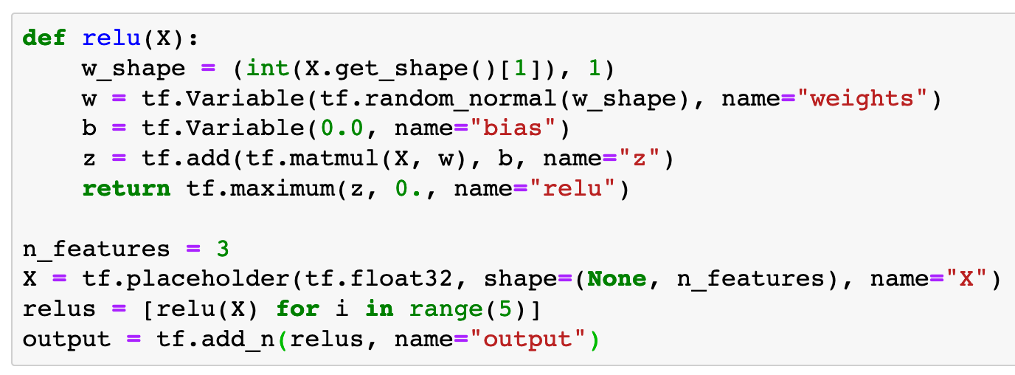

Slide 14
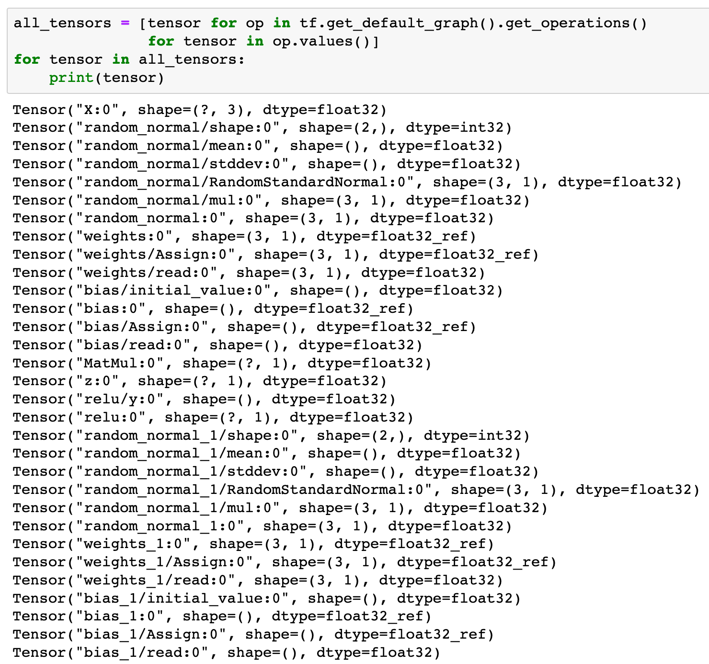

Slide 20
name
is used
to distinguish
variables

Slide 21
Code Modularity 2

Slide 23
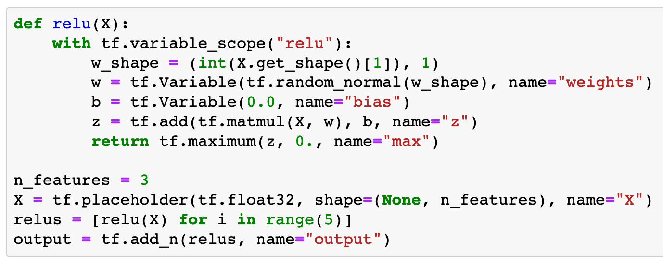

Slide 24
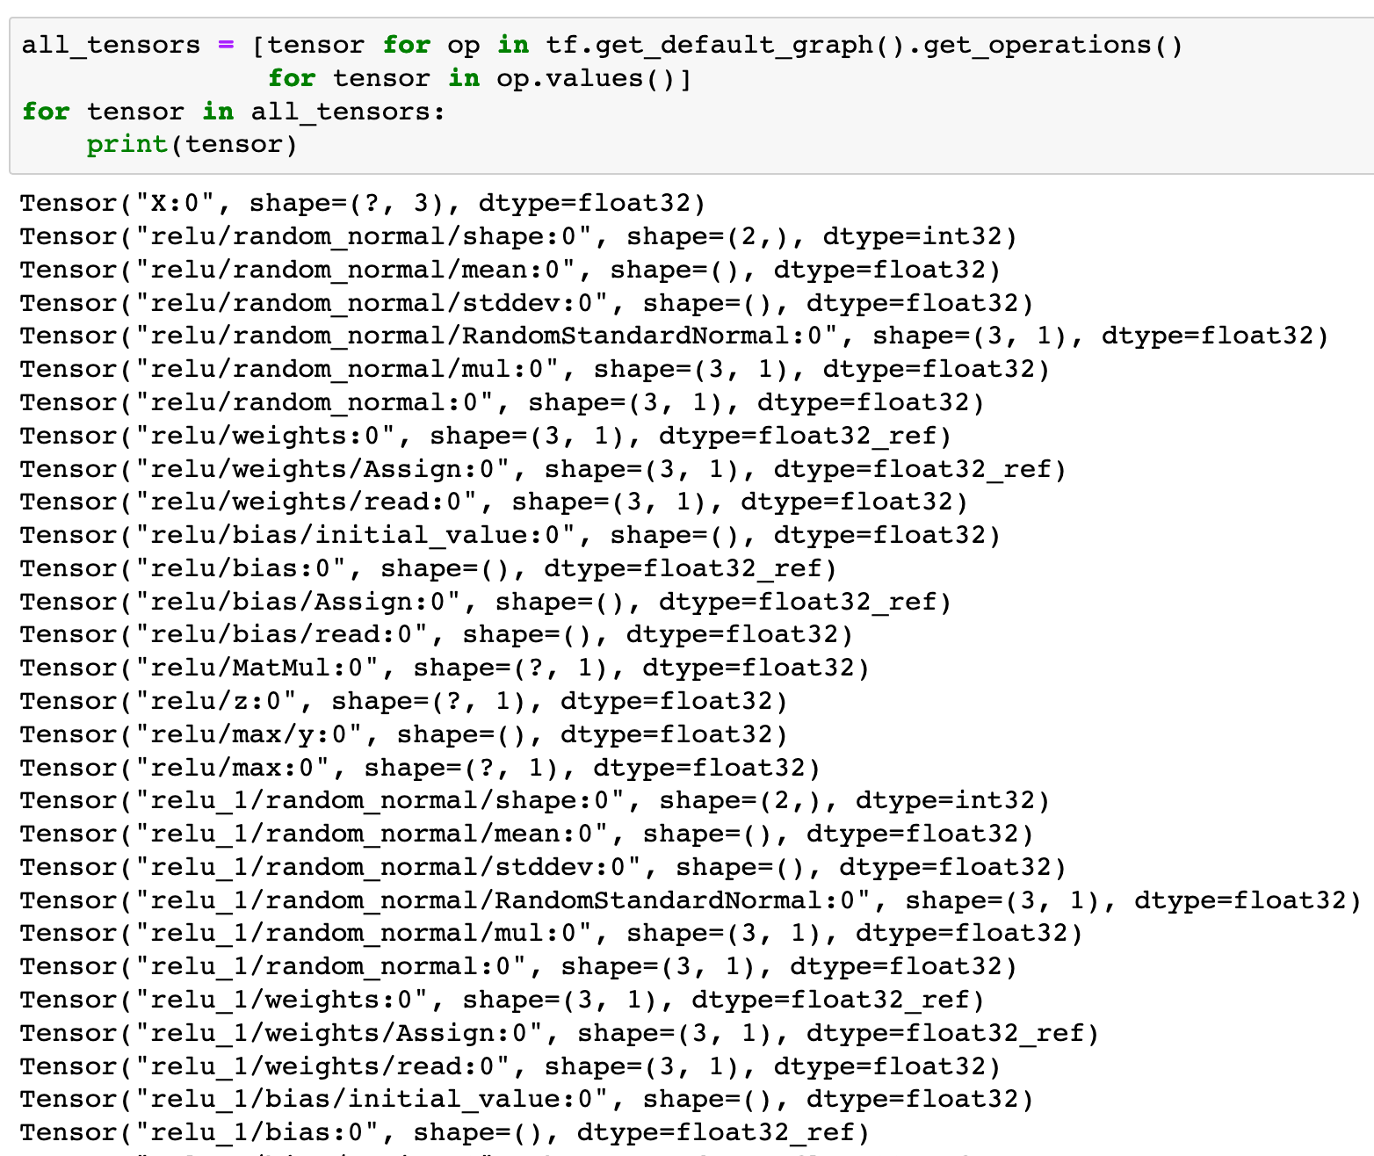

Slide 30
variable scope
is used
to distinguish
variables

Slide 31
Now
Let’s Play with Code

